Slide 1
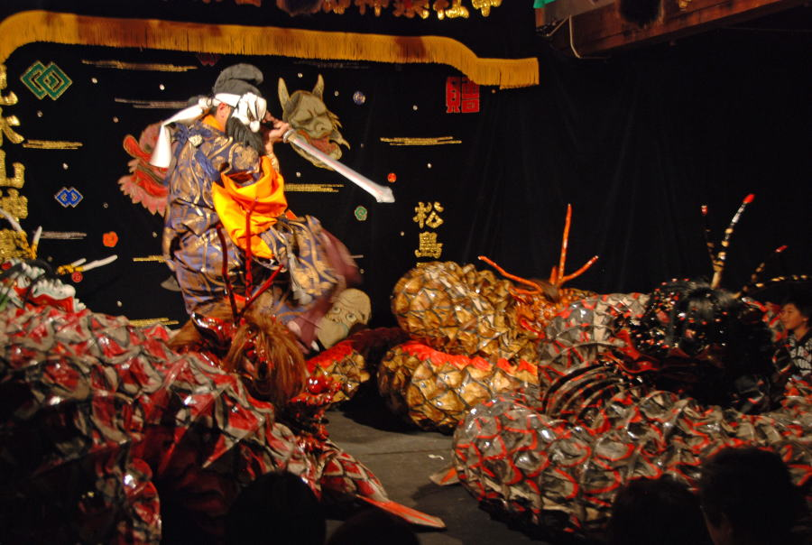
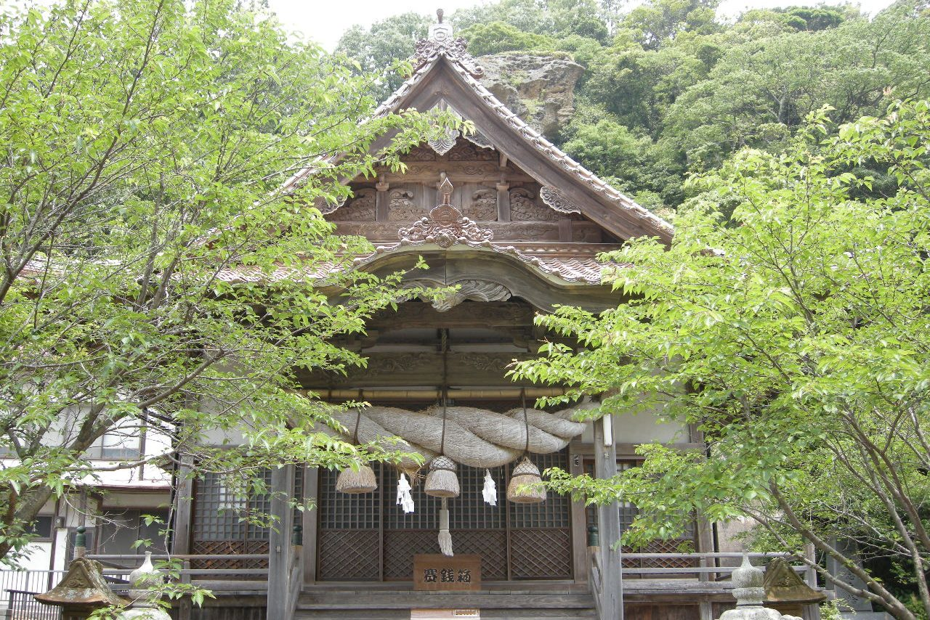
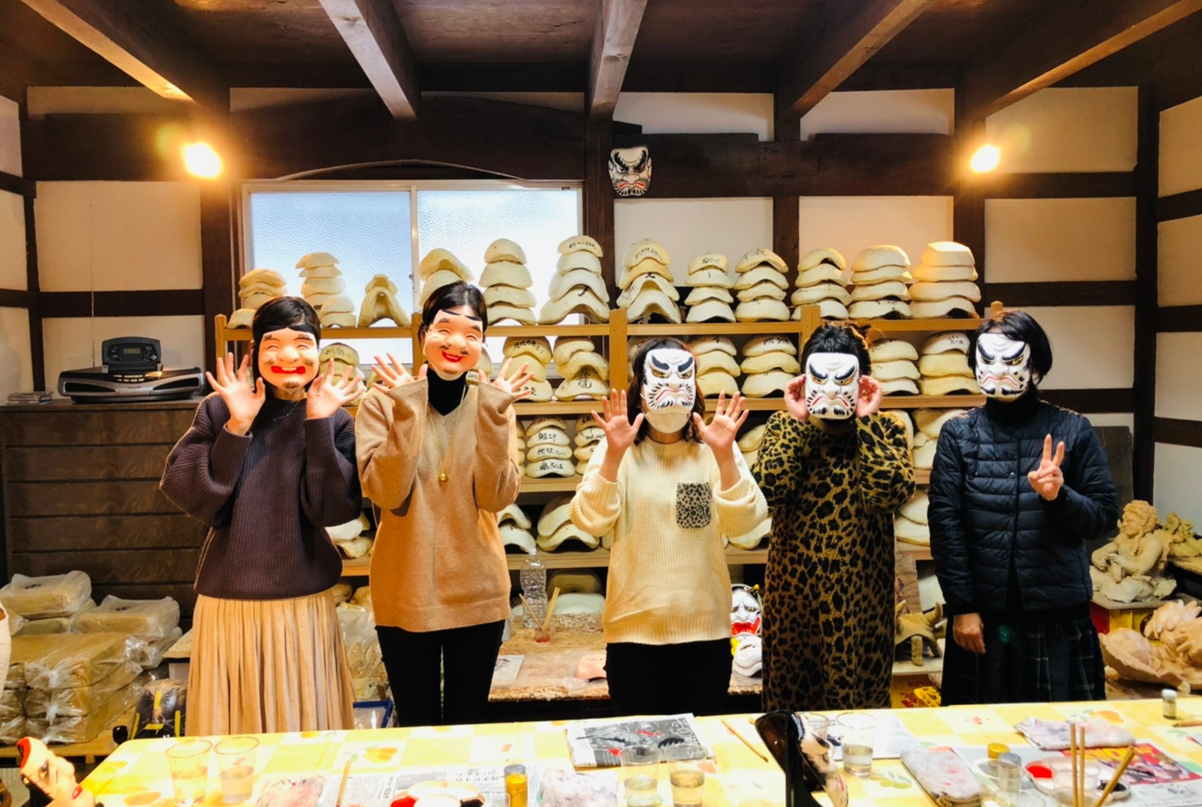
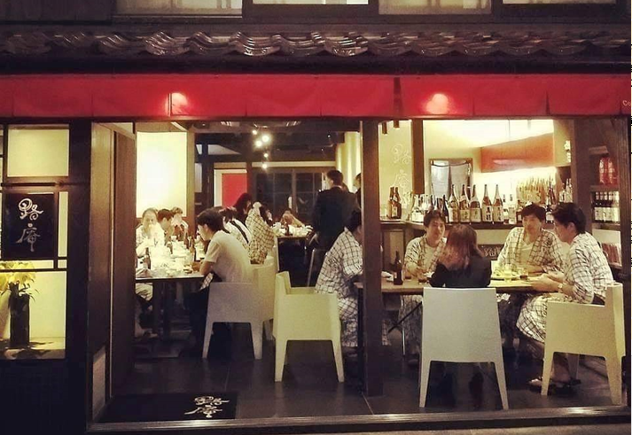
① A special evening “Kagura” Performance to be enjoyed with all 5 senses
Oda City/Shimane/Japan
Precautions against Covid19:
■Venues and staff involved in the experience: ☑Temperature check ☑Wearing masks ☑Hand sanitizer□Cashless payment ☑Room ventilation
■Requests to travellers: ☑Temperature check ☑Wearing masks☑Hand sanitizer☑Providing contact info
Ideal for: | Individual travellers and small groups
Target market: | Couples and small groups Travellers in their 20s to 60s, interested in experiencing local culture
Experience price （incl. tax）: | Package price: from 16,500 JPY per person ・Mask painting experience: 8,500 JPY ・Dinner at Roan（路庵）Meal: 3,000 JPY, drinks to be paid upon consumption ・Special Iwami Kagura performance: 5,000 JPY/30seats ※The special performance includes time to interact with Kagura performers
The above price includes: | Iwami Kagura Performance, Mask painting experience, dinner at Roan「路庵」
Meeting point: | Kobayashi Kobo for Mask painting experience
Access: | One minute walk from JR Yunotsu Station
Reservations accepted from: | Reservations accepted from a month before the Kagura performance
Available dates: | Inquiry required(regular performance held every Saturday night 20:00-21:00 2,000JPY)
Duration and starting time: | Kagura performance: 2 hours, Dinner 1.5 hours, Mask painting experience 1.5 hours
Min/max guest number: | 2-20
Shared/private: | ※Private kagura performances available upon request（120,000 JPY）
Available languages: | ※Limited to accompanying guide
Tour overview:
Get familiar with the intriguing world of Iwami Kagura - a traditional sacred performance with a long history that goes back to the legendary roots of Japan. First, check-in to your traditional accommodation at Yunotsu Onsen and feel free to enjoy the onsen hot springs before a traditional kaiseki style meal made using the freshest local ingredients accompanied by locally produced sake. After dinner, move to the local Shinto shrine for a special Kagura performance, which will take place as in the ancient times: under candle light illumination. Regularly held Kagura performances are part of this town’s life and the audience is mostly composed of local people participating in this charming traditional event. While Kagura is a sacred performance with strong links to Shinto religion, it is overall a colourful, lively and entertaining show that can be enjoyed by everyone. *As a recommended option, you have the chance to also interact with the performers and create your own Kagura performance mask, a very special and unique souvenir to bring home.
Precautions against the spread of Covid19 infection:
Audience is asked to wear a mask during the kagura performance. Hand sanitizer is provided at the entrance of the venue. During meals, reduced number of people per table and social distancing.
Contact information:
■Experience provider：Yunotsu Onsen Ryokan Association ■Business Hours：9:00 - 17:00 ■Website： http://www.yunotsu-onsen.com ■Phone number：0855-65-2998 ■Email：yunotsu.kankou@gmail.com

